Slide 1
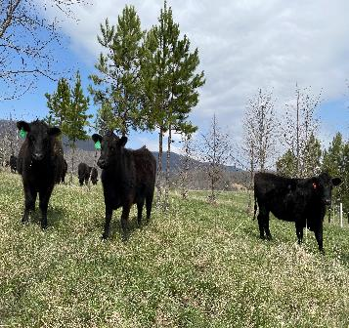
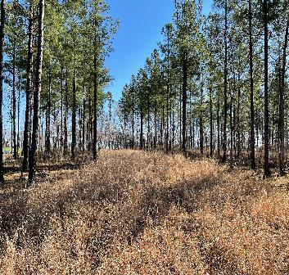
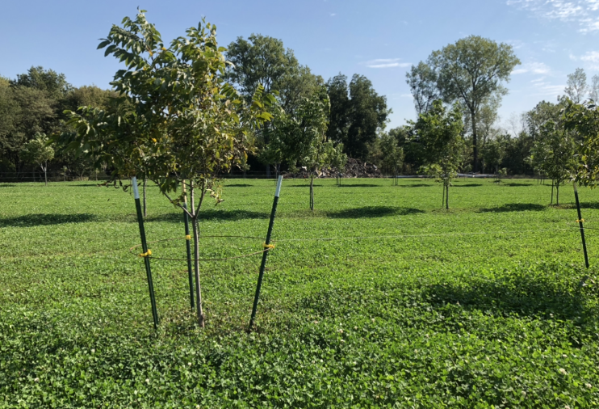
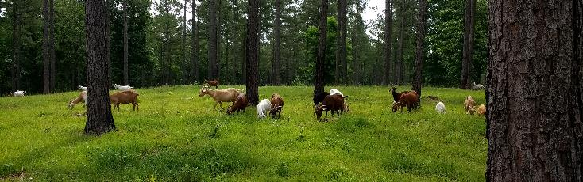
An Introduction to Silvopasture Systems
Notes:
Presentation was completed by Joe Alley – NRCS National Agroforester

Slide 2
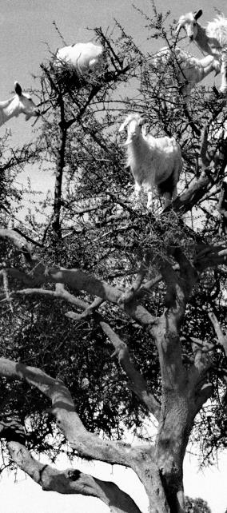
Overview
  Agroforestry and Silvopasture Defined
  Why Does Silvopasture Work?
  Silvopasture Establishment Overview

Slide 3
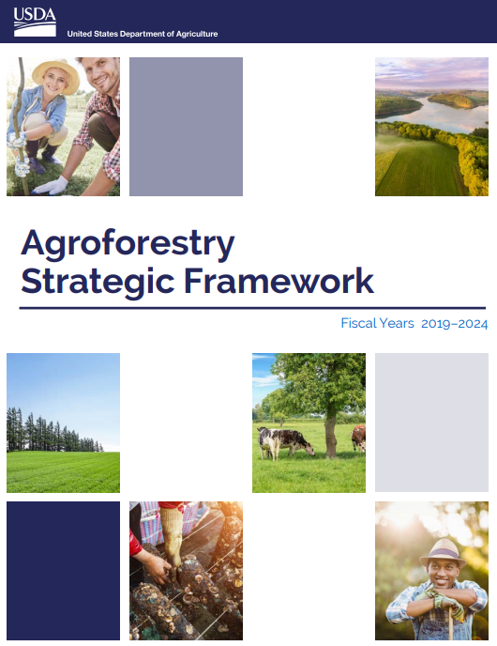
Agroforestry Is….
The intentional integration of trees or shrubs with crop or animal production to create environmental, economic, and social benefits (USDA Agroforestry Strategic Framework, Fiscal Years 2019-2024).
Working Trees for Agriculture and People!
Notes:
Before we learn about silvopasture, we need to have an understanding of what agroforestry is…because silvopasture is an agroforestry practice. The definition here is from the USDA Agroforestry Strategic Framework, and is what we can hang our hats on at NRCS. Note the two words that are underlined; intentional and integrated. These are very important criteria to recognize when describing and managing agroforestry systems.
“Working trees for Agriculture and People” is another way to think about agroforestry. Think of it as trees integrated into agricultural systems for a purpose that contributes to the ag operation.
Other Defs – not included in presentation
Agroforestry is a management system that combines agriculture and trees to address conservation needs and build more profitable and weather-resilient farms, ranches and communities (National Agroforestry Center https://www.fs.usda.gov/nac).
NCA5 definition - Collective name for land-use systems and technologies where woody perennials (trees, shrubs, palms, bamboos, etc.) are deliberately used on the same land-management units as agricultural crops and/or animals in some form of spatial arrangement or temporal sequence. In agroforestry systems, there are both ecological and economic interactions between the different components. Agroforestry can also be defined as a dynamic, ecologically based, natural resource management system that, through the integration of trees on farms and in the agricultural landscape, diversifies and sustains production to increase social, economic, and environmental benefits for land users.7

Slide 4
Agroforestry is…
“…a management system that combines agriculture and trees to address conservation needs and build more profitable and weather-resilient farms, ranches and communities. Agroforestry practices provide opportunities to integrate productivity and profitability with environmental stewardship resulting in healthy and sustainable agricultural systems that can be passed on to future generations.” National Agroforestry Center
“…an intensive land management system that optimizes the benefits from the biological interactions created when trees and/or shrubs are deliberately combined with crops and/or livestock…Within each agroforestry practice, there is a continuum of options available to landowners depending o­n their own goals…” Association for Temperate Agroforestry
“…Diversified farming and ranching systems that include trees and other perennial shrubs and crops.” “…an umbrella term encompassing a variety of polycultural farming practices that intentionally integrate perennial trees and shrubs with other crops and/ or livestock.” Agroforestry Coalition
Notes:
Lets quickly look at a few definitions from respected groups in the world of agroforestry in the U.S. We don’t need to read these, just recognize that while each group puts a little different spin o the definition, the take home is the same.

Slide 5
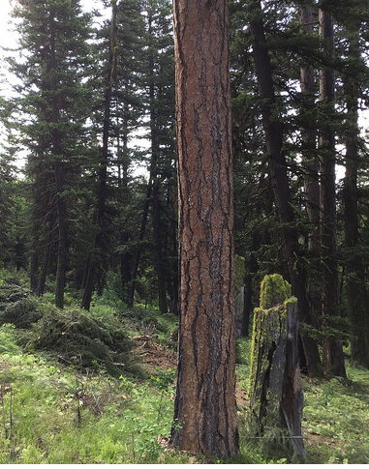
Agroforestry Is NOT Conventional Forestry
  Agroforestry Includes aspects of forestry BUT also equal or greater aspects of farming or livestock management.
  Agroforestry tree components may be managed for traditional wood products…or may be managed for non-timber products, livestock benefits, or conservation benefits only.
Notes:
There are a lot of misconceptions associated with agroforestry and it is sometimes helpful to also identify things that are NOT agroforestry.
To begin with, agroforestry is not associated with conventional forestry. Agroforestry is not about managing forests as forests. Read slides…

Slide 6
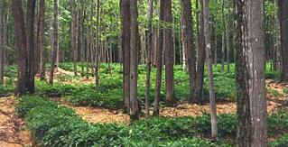
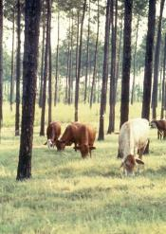
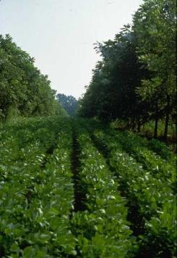
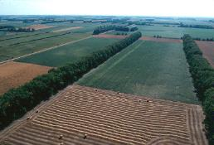
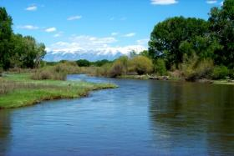
Agroforestry Is NOT…
A New Concept
A single practice
Notes:
Indigenous cultures have been practicing agroforestry for a long time and we need to expand our perceptions to understand and appreciate this. Consider the definition of agroforestry within the context of Indigenous American’s traditional approach to woodland management. For example, selecting for and planting desired species and using fire and other techniques to maintain them is a form of forest farming. Similar instances exist worldwide with indigenous cultures and other forms of pre-industrial agriculture.
Not a single practice – this misconception seems to be place-based. My early education and experience with agroforestry is in the Midwest where alley cropping with black walnut was a big deal. As a result, many folks from that region and time think of agroforestry as alley cropping only.

Slide 7

Agroforestry Practices
311 – Alley Cropping
379 – Forest Farming
380 – Windbreak/Shelterbelt Establishment and Renovation
381 – Silvopasture
391 – Riparian Forest Buffers
Notes:
NRCS recognizes five agroforestry practices.
However, Agroforestry is not necessarily limited to our 5 practices either. We recognize these practices specifically because of their purposeful and unique designs. However, we can often achieve similar objectives through other practices such as tree establishment or tree thinning.

Slide 8

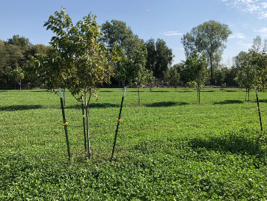
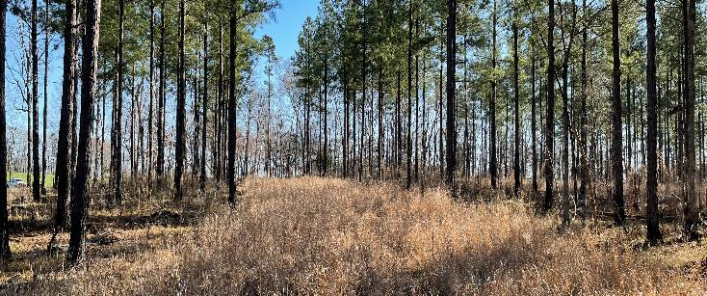
Silvopasture Defined
Notes:
Ok, now that we have an understanding of agroforestry, lets dig in and define silvopasture.

Slide 9
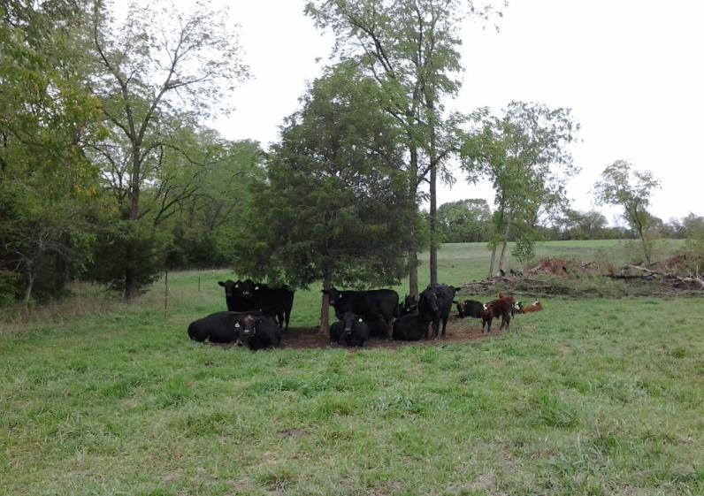
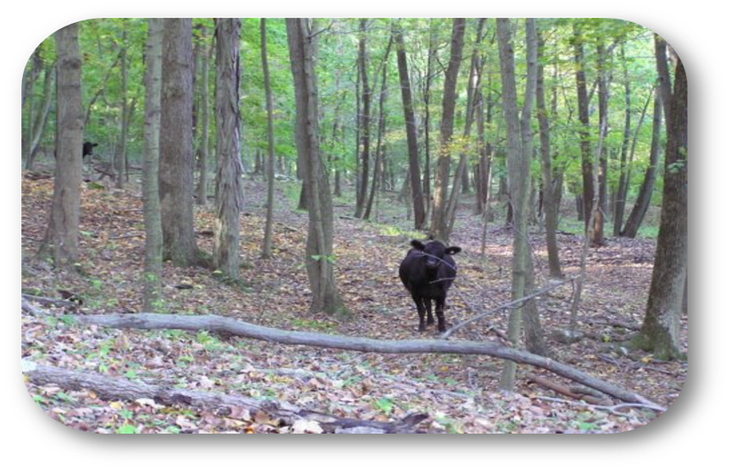
NOT Silvopasture
Notes:
And lets start with understanding what silvopasture is not. These images are good examples of NOT silvopasture.
On the left, we see a group of cattle loafing under a single tree. The ground is bare under the tree and we can assume compaction is high, which will negatively affect tree growth. Also, nutrients are concentrated in this one area. More trees spread out in this pasture would alleviate this condition.
On the right, the cow has plenty of shelter but essentially no forage, so feed and forage balance is a limiting factor. If this area is being managed as forest, then the presence of livestock are detrimental to seedling regeneration and there may be impacts to soil health also.
These two images are not silvopasture because the trees, forages, and livestock are not intentionally integrated into a sustainable system that benefits each component.

Slide 10
Silvopasture – CPS 381
Establishment and/or management of desired trees and forages on the same land unit.
Notes:
This is the current (prior to FY25) NRCS CPS definition. Honestly, it is a little vague.

Slide 11
Silvopasture – CPS 381 continued
Establishment and/or management of desired trees and forages on the same land unit.
Draft - An agroforestry practice that intentionally integrates trees or shrubs with forages and livestock for production and conservation benefits on the same land unit.
Notes:
Here is a version of a revised definition (hopefully in place for FY26)

Slide 12
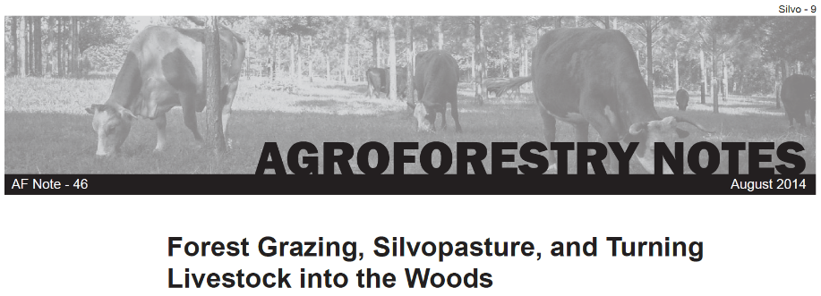
Three Scenarios
  Turning Livestock into the Woods
    Forest-Grazed; Not Silvopasture
  Forest Grazing
    Range?; Not exactly Silvopasture
  Silvopasture
https://www.fs.usda.gov/nac/assets/documents/agroforestrynotes/an46si09.pdf
Notes:
It can be a little challenging to separate silvopasture from other situations that involve livestock and trees. To help with this, lets take a few minutes to step a little outside of the NRCS bubble and discuss this document developed by NAC (national agroforestry center) and a previous NRCS National Grazing Specialist (Syd Brantley). We’ll go through a few diagrams over the next few slides.
Authored by Syd Brantley, NRCS National Grazing Specialist

Slide 13
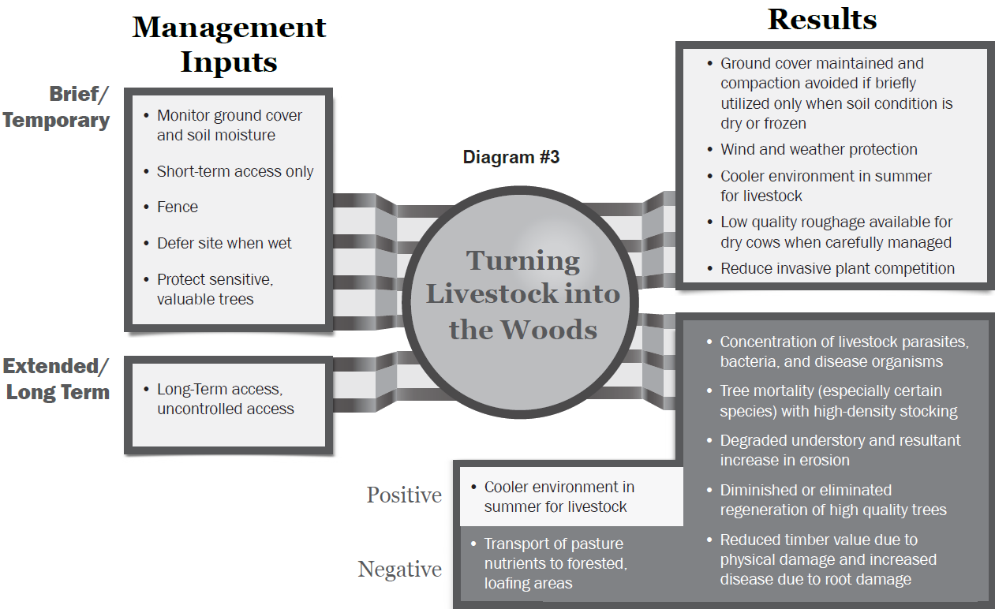
1
Notes:
The first scenario we’ll consider is just turning livestock into the woods, which is a common practice. From the agroforestry note, “Turning Livestock into the Woods (as depicted in Diagram #3) is usually based on the need for additional forage or browse, to rest other pastures and sometimes just the need to reduce environmental stress on animals. … However, when a relatively large number of cattle have uncontrolled access to forest for long periods of time, timber production and forest attributes will almost always degrade”.

Slide 14
Forest - Grazed
Notes:
To think of this in NRCS planning terms, this scenario would be defined as Forest with a Grazed modifier in Conservation Desktop

Slide 15
Forest – Grazed..
Notes:
Turning livestock into the woods can go two ways. Fairly light impact with short term access (shown above the red line). Or mostly degradation of the resource with long term, uncontrolled access (below the red line)

Slide 16
Forest – Grazed.
Compaction,
Minimal Forage,
Shift in tree spp Composition.
Notes:
Putting a bit more of forest health focus on this, these are the things that stand out.

Slide 17
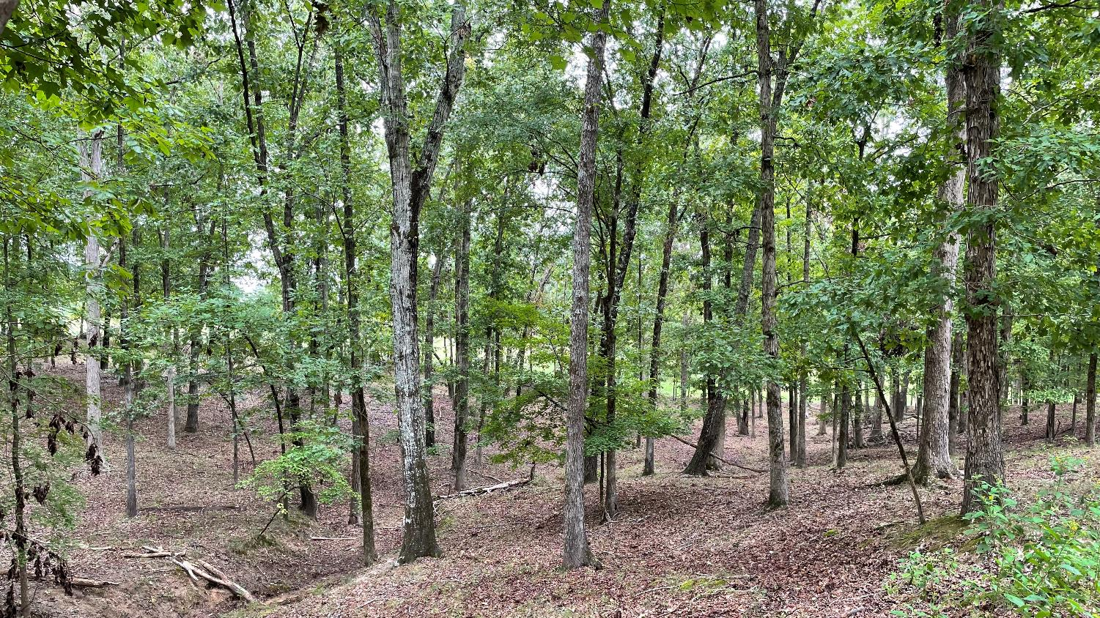
2
Notes:
This is a pretty good example (definitely not the worst though) of long term access. Note the lack of vegetation in the understory and unprotected creek bank.

Slide 18
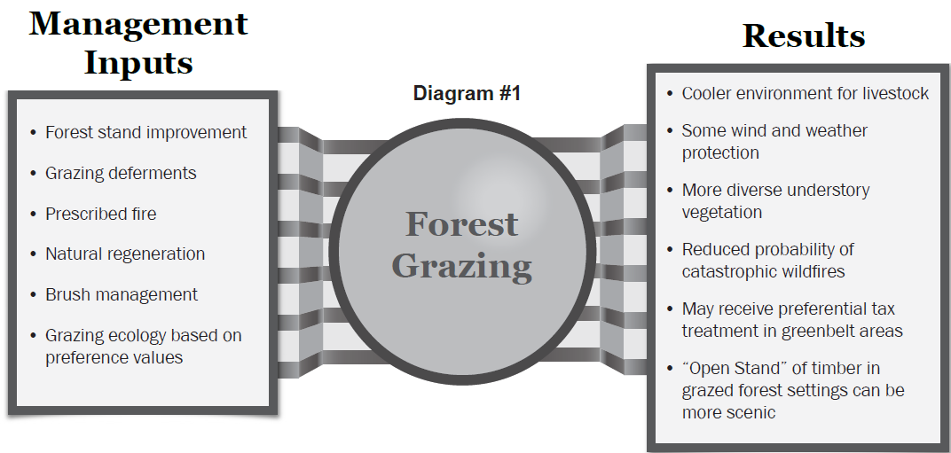
7
Notes:
Forest grazing is another angle on trees and livestock. This scenario is really about utilizing livestock to manage native plant communities with an ecological systems approach. Some types of range would fit very well into this scenario, such as native longleaf pine in the southeast or ponderosa pine in west. This can be a little hard to separate from silvopasture, and the difference may not really matter if the three components of the system are all benefiting. A key difference is probably the word “pasture” in silvopasture versus what is being presented here. NRCS definition of range is defined by native plants and typically (not always) silvopasture is based around introduced forages and/or more structured tree arrangement.

Slide 19
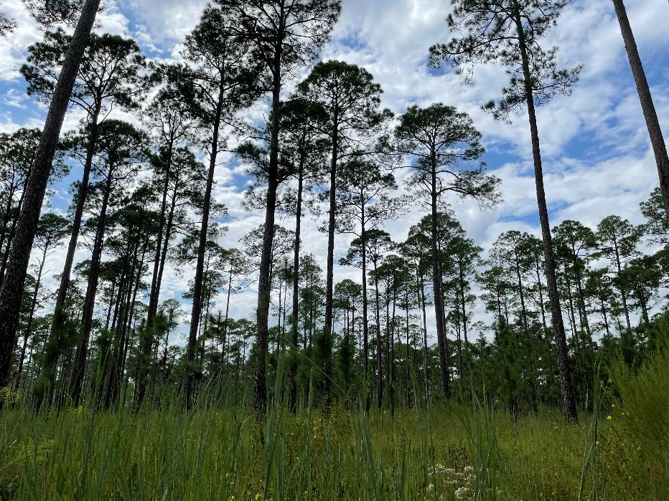
8
Notes:
This image shows a native longleaf pine – wiregrass system in southern Georgia. This is an example of a grazed forest, per this agroforestry notes definition. For many of us, we would probably call this range and it think that is appropriate.

Slide 20
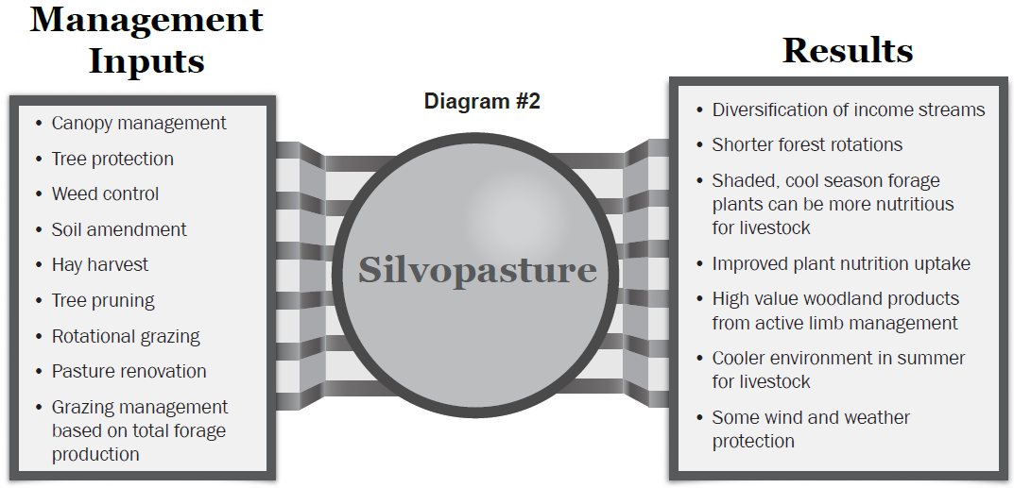
9
Notes:
“Silvopasture management (as depicted in Diagram #2) is based on the agronomic and forestry principles used to profitably produce and harvest forage and forest products, guided by the limitations and potential of the land. … Tree species are selected that have an economic potential and meet forage light requirements. Forages are selected that thrive in the range of sunlight penetration that is anticipated with the given canopy management. The forest management, pasture management, and grazing management is conducted in harmony, enhancing the production of multiple, harvestable components.”

Slide 21


10
Notes:
Silvopasture is different than the two previous scenarios. From the agroforesty note, “Silvopasture management (as depicted in Diagram #2) is based on the agronomic and forestry principles used to profitably produce and harvest forage and forest products, guided by the limitations and potential of the land. … Tree species are selected that have an economic potential and meet forage light requirements. Forages are selected that thrive in the range of sunlight penetration that is anticipated with the given canopy management. The forest management, pasture management, and grazing management is conducted in harmony, enhancing the production of multiple, harvestable components.”

Slide 22
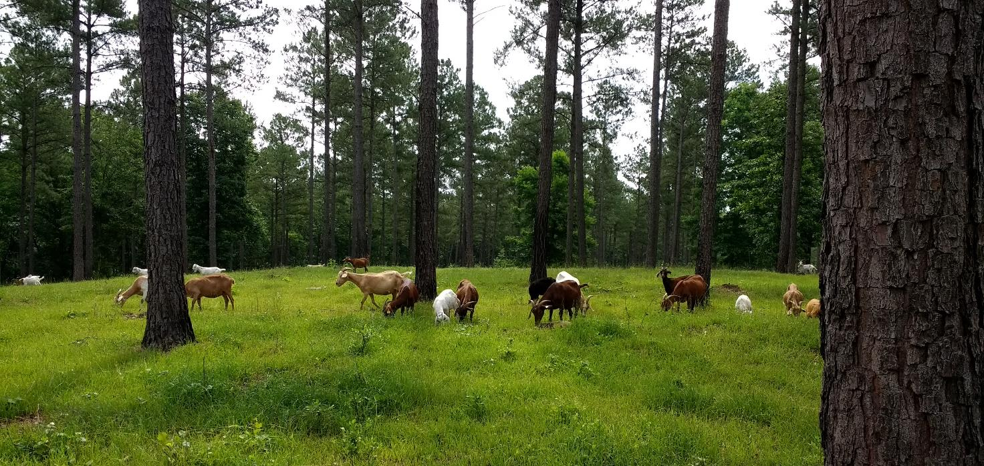
11
Notes:
A good example of a silvopasture with goats grazing on introduced forages under a thinned loblloly pine stand.

Slide 23
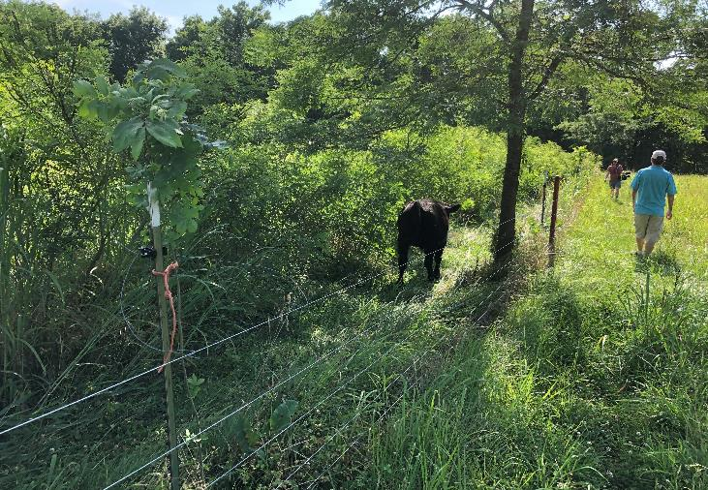
Why Does Silvopasture Work?
Notes:
Now that we know what silvopasture is, lets talk about why it works.

Slide 24
Silvopasture – CPS 381 – Purposes
Provide forage, shade, and/or shelter for livestock.
Improve the productivity and health of trees/shrubs and forages.
Improve water quality.
Reduce erosion.
Enhance wildlife habitat.
Improve biological diversity.
Improve soil quality.
Increase carbon sequestration and storage.
Provide for beneficial organisms and pollinators.
Notes:
This slide shows all of the purposes for silvopasture. We will take a closer look at a few of the more commonly applicable purposes and discuss the associated resource concerns.

Slide 25
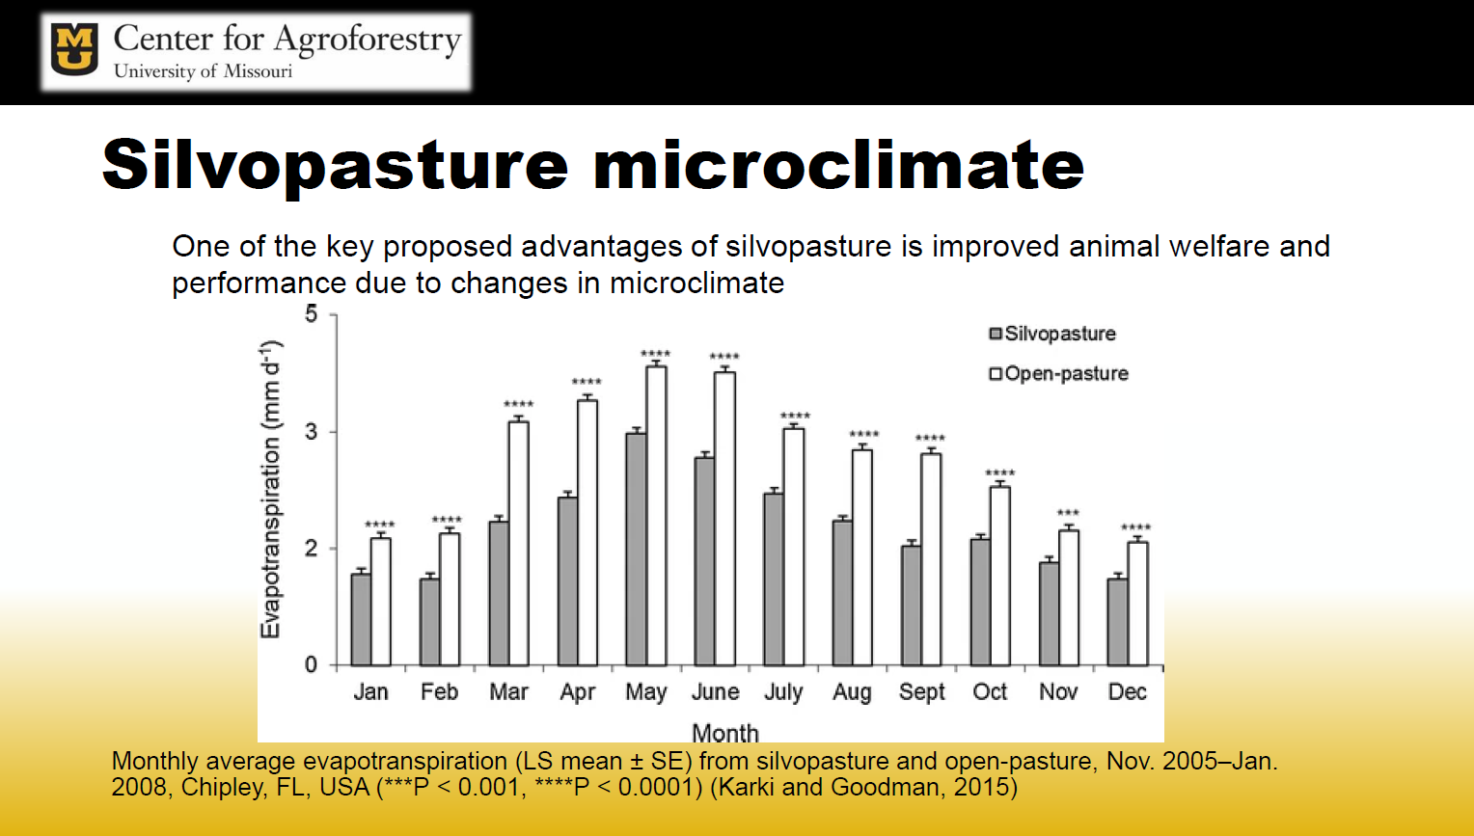
12
Notes:
A key aspect of most agroforestry practices is the impact of trees on the local microclimate. This image from the University of Missouri shows differences in evaportranspiration rates in a silvolpasture vs an open pasture. The conservation of moisture has many benefits. (discuss)

Slide 26
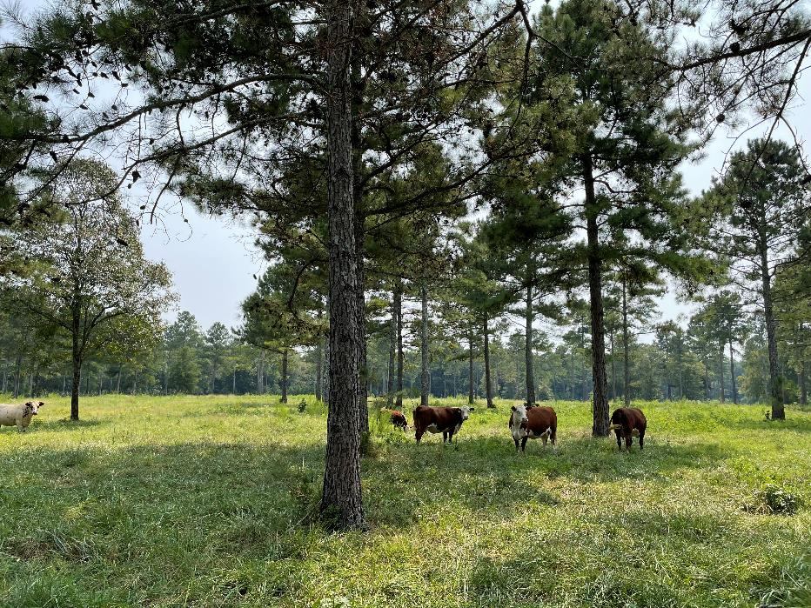
13
Notes:
This image shows a couple of things. First, the cows are utilizing the shade. And they are doing that for the same reason that we would; its cooler and more comfortable. The other thing that is not so obvious is the improved forage growth in the shade. This is a cool season forage which benefits from cooler growing conditions (including cooler soil temps) and reduced transpiration rates.

Slide 27
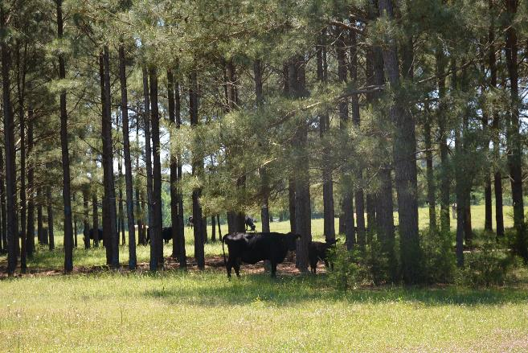
Tree Selection Considerations
Adapted to site
Compatible with forage and livestock
Leaf shape and phenology
Mast for supplemental feed
Adapted to management
Soil benefits
Timber and non-timber products
Adapted to expected changes
Notes:
Not all trees are created equal for silvopastures and a variety of factors need to be considered.
Adapted to site = soil, climate, localized limitations
Compatible with forage and livestock = avoid allelopathic interactions; avoid trees that may produce plant parts that are toxic to planned livestock
Leaf shape and phenology = impact on shading; pine needles allow light infiltration, as does honeylocust, walnut, and other narrow-leafed trees. Late leaf out and early leaf drop (black walnut).
Mast for supplemental feed = honeylocsut pods, mulberries, persimmon, et
Adapted to management = pruning, resprouting, regeneration
Soil benefits = nitrogen fixers, fast OM turnover
Timber and non-timber products = long lived trees and solid wood products are best for C capture. Other products that have value
Adapted to expected changes = climatic changes, changes in livestock, changes in local site conditions

Slide 28
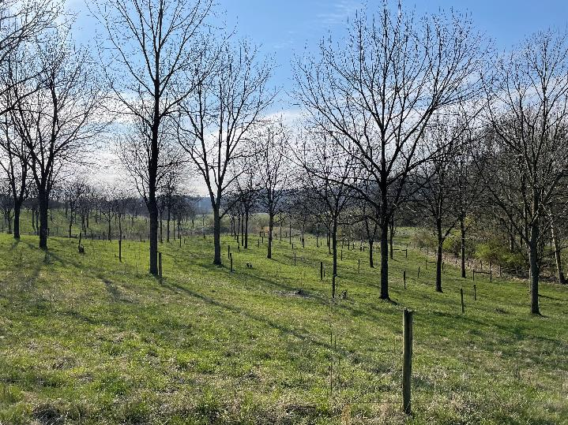
“Plots under black walnut yielded 13% more forage than those under honey locust (5790 vs. 5130 kg ha-1) for trees less than seven years old. Forage under honey locust had more growth with older trees.“
USDA-ARS, Dr. John Fike VATech and associates;
Forage Growth under Black Walnut and Honey Locust
Notes:
As mentioned privously, tree selection can have a significant impact on forage growth and livestock performance. A couple of prime silvopasture trees are black walnut and honeylcoust. Both produce a light shade. Black walnut is valued for its timber and nuts. Honeylocust, produced pods that can provide supplemental forage for livestock (they may need to be trained to consume the pods). Recognize that honeylocust is typically thorny. Thornless varieties are available as are a few selection of thornless with heavy pod production. However, seeds from these trees may produce thorny sprouts, so this requires a high level of management. This image is from a fairly famous study site at Virginia Tech (famous within silvopasture world). Early results of this study showed substantially higher forage production under black walnut. However this shifted as the trees grew larger. Reasons are not clear, though honeylcoust is a legume and may ultimately be adding effective N to the soil for forage uptake. Also, shade from honeylocust is somewhat lighter, promoting more forage growth.

Slide 29
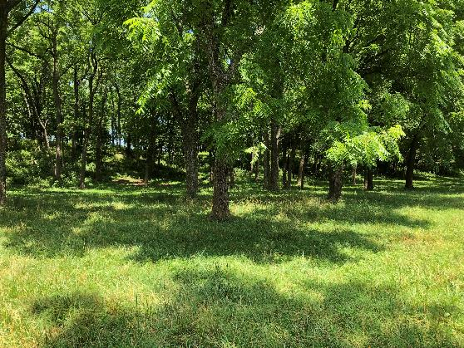
Forage Selection Considerations
Adapted to site
Transition over time
Compatible with trees and livestock
Adapted to shade
  Cool Season (C3) forages – Target 40-50% shade (60-50% sun)
  Warm Season (C4) forages – Target 30-40% shade (70-60% sun)
Notes:
Forage selection is a very important decisions in silvopasture design. In general, cool season spp are better adapted to shade than warm season forages.
Adapted to shade = threshold values. Beyond these values (heavier shade), forage production continues, but declines rapidly. However, depending on management objectives, some avaialility of deeper shade may be desirable.
Over time, trees grow larger and shade may increase. Thinning and pruning trees can offset this process. Over time, it may be necessary to shift forage species or shift towards another management objective, such as timber. Or, it may be time to cut the trees and reset the system.

Slide 30
PAR and C3 vs C4
Net photosynthesis as a function of photon flux density in the PAR range in maize (C4 plant) and cotton (C3 plant) (Jose,
unpublished data).
Notes:
To dig further into warm season vs cool season…this graph charts photosynthetically active radiation (PAR) on the X axis vs net photosynthesis on the Y axis. In other words, light vs vegetative growth. The straight line shows results for corn which is a warm season or C4 plant. The curved line shows results for cotton, a C3 plant. Cool season forages are C3 plants. If you have forgotten plant physiology, C3 and C4 are the differently photosynthetic pathways that warm season vs cool season plants use. What the chart shows us is that corn (representing a warm season forage) will continue to grow more vegetative matter as light continues to increase. On the other hand, cotton (representing a cool season forage) hits a point where it is maxed out on light. It can’t grow any more vegetatively, no matter how much light is available.
In summary, this is why cool season forages are well suited for silvopasture systems; they can grow in some level of shade. Warm season forages are less adapted to silvopasture systems, though they can work with good planning.

Slide 31
14
Notes:
This chart shows the relative shade tolerance of a variety of plants under 50% shade. Note that these are not absolute values but instead show shade tolerance relative to other species in the study, and this is just a sample of species from this study. The point is to demonstrate the range in relative adaptability to shade. See that switchgrass and Indian grass are at the top, indicating they are less tolerant than the other spp shown. Eastern gama grass is a bit of an outlier since it is a warm season plant.
These Data were compiled from multiple studies with forages grown in controlled shade environments, mostly in pots. Each study compared production in shade to production in full sun and expressed those differences as percentages of production in full sun. Each bar represents relative shade tolerance indicating difference in yield in shade vs full sun. Lower values indicate greater difference between shade and full sun production. Higher values indicate lower difference between shade and full sun production. Using these relative values allows us to compare these differences between species and “ranking” as a percentile (percentile describes how each value compares to others). summary compares these results in relation to each other for each species, only showing their relative tolerance/intolerance when compared to other forages. Data summarized from
Ranking the Shade Tolerance of Forty-five Candidate Groundcovers for Agroforestry Plantings By J. W. Van Sambeek1 , N. E. Navarrete-Tindall2 , H. E. Garrett3 , C.-H. Lin3 , R L. McGraw4 , and D. C. Wallace5 1Research Plant Physiologist, North Central Research Station, 202 Natural Resource Building; 2 Senior Research Scientist, Plant Sciences Division, 203 Gentry Hall; 3 Professor and Research Assistant Professor, respectively, UMC Center for Agroforestry, 203 Natural Resource Building; 4Associate Professor, Department of Agronomy, 208 Waters Hall, University of Missouri, Columbia, MO 65211; and 5NRCS State Forester, Natural Resource Conservation Service, 601 Business Loop 70W, Suite 270, Columbia, MO 65203.

Slide 32
15
Notes:
Here is more data, this time at the 75% relative shade tolerance level. The curve shape is more linear and overall shade tolerance values are lower for most spp, compared to what was shown at 50% (just the fitment of the curve).
Data compiled from multiple studies with forages grown in controlled shade environments, mostly in pots. Each study compared production in shade to production in full sun. This summary compares these results in relation to each other for each species, only showing their relative tolerance/intolerance when compared to other forages. Data summarized from
Ranking the Shade Tolerance of Forty-five Candidate Groundcovers for Agroforestry Plantings By J. W. Van Sambeek1 , N. E. Navarrete-Tindall2 , H. E. Garrett3 , C.-H. Lin3 , R L. McGraw4 , and D. C. Wallace5 1Research Plant Physiologist, North Central Research Station, 202 Natural Resource Building; 2 Senior Research Scientist, Plant Sciences Division, 203 Gentry Hall; 3 Professor and Research Assistant Professor, respectively, UMC Center for Agroforestry, 203 Natural Resource Building; 4Associate Professor, Department of Agronomy, 208 Waters Hall, University of Missouri, Columbia, MO 65211; and 5NRCS State Forester, Natural Resource Conservation Service, 601 Business Loop 70W, Suite 270, Columbia, MO 65203.

Slide 33
Other Considerations for Forages
Timing of Forage Availability
Quality vs Quantity
Notes:
A couple other things to consider for forages…

Slide 34
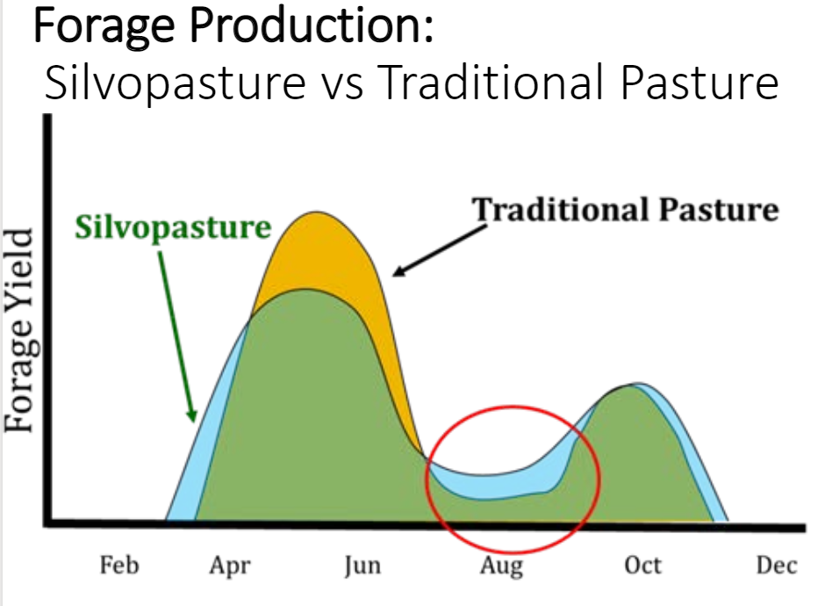
16
Notes:
This image overlays forage yields in a silvopasture vs traditional open pasture for cool season forages. The yellow bump shows where open grown forage outperforms silvopasture in the spring. Note that this is a single spike in production that can be hard to keep up with and fully utilize. The blue areas show where silvopasture helps optimize yields and spread them more evenly over the year. Importantly, cool season forages in silvopastures can avoid some of the “summer slump”. Additionally, we see extended growing seasons in early spring and late fall. Not a lot but measurable, enough to reduce a week or two of hay feeding. This benefit to forage is all due to tree effects on the microclimate.
Source: Adapted from Walters, 2011. UM Center for Agroforestry

Slide 35
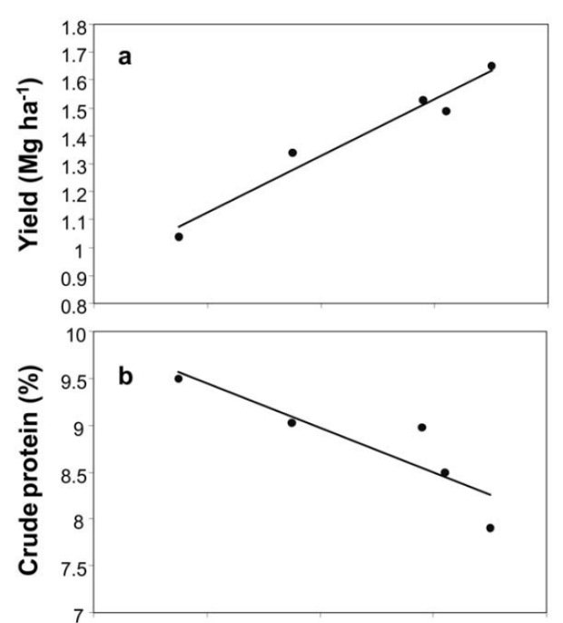
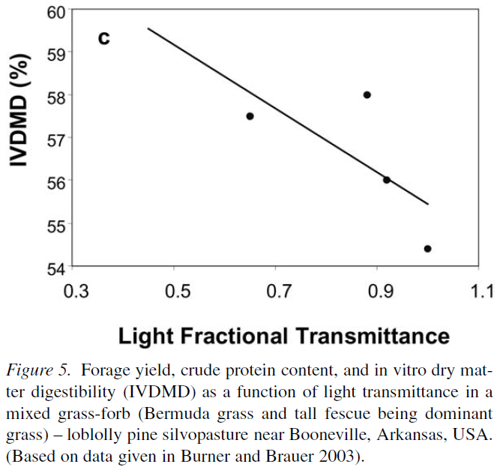
17
Notes:
This study compared yield (top left), crude protein (lower left), dry matter digestibility (upper right), all as a function of light transmittance (x-axis for upper right chart is same for two charts on left). Forage was a combination of Bermuda grass and fescue. The study shows that forage yield increased as light increased. However, crude protein and digestibitility (aka, quality) decreased with light. There are many factors to consider here, one is that the lower light levels kept the forage in a more vegetative state. Nevertheless, the effect on quality is an important consideration. What this means is that while we can expect higher yields in more open conditions, we can manage for better quality forage in a shade environment that is more comfortable for animals to graze in.

Slide 36
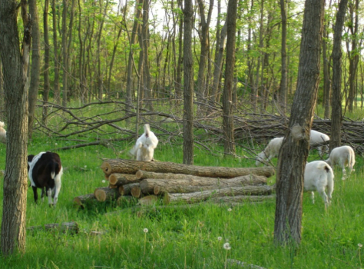
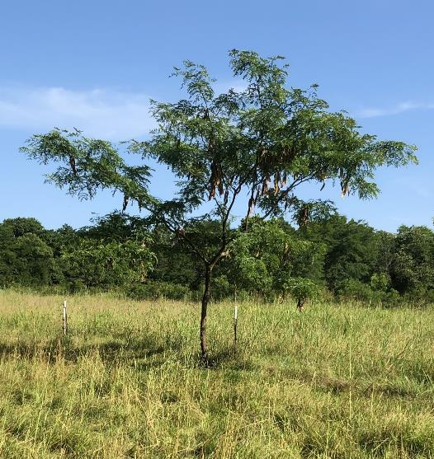
Livestock Benefits
Shade/shelter = happy livestock
Supplemental feed
  Mast
  Leaves…
Notes:
Lets now talk about livestock effects.

Slide 37
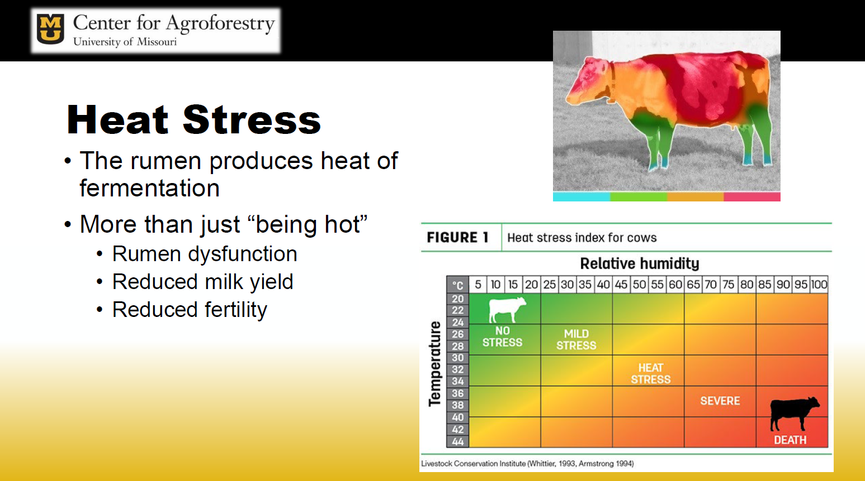
18
Notes:
Heat stress is a real issue and livestock are lost each year to the effects. Its more than just being hot, there are cascading effects that impact rumen function, milk production, and fertility. Image used with permission from Dr Ashley Conway, U of MO

Slide 38
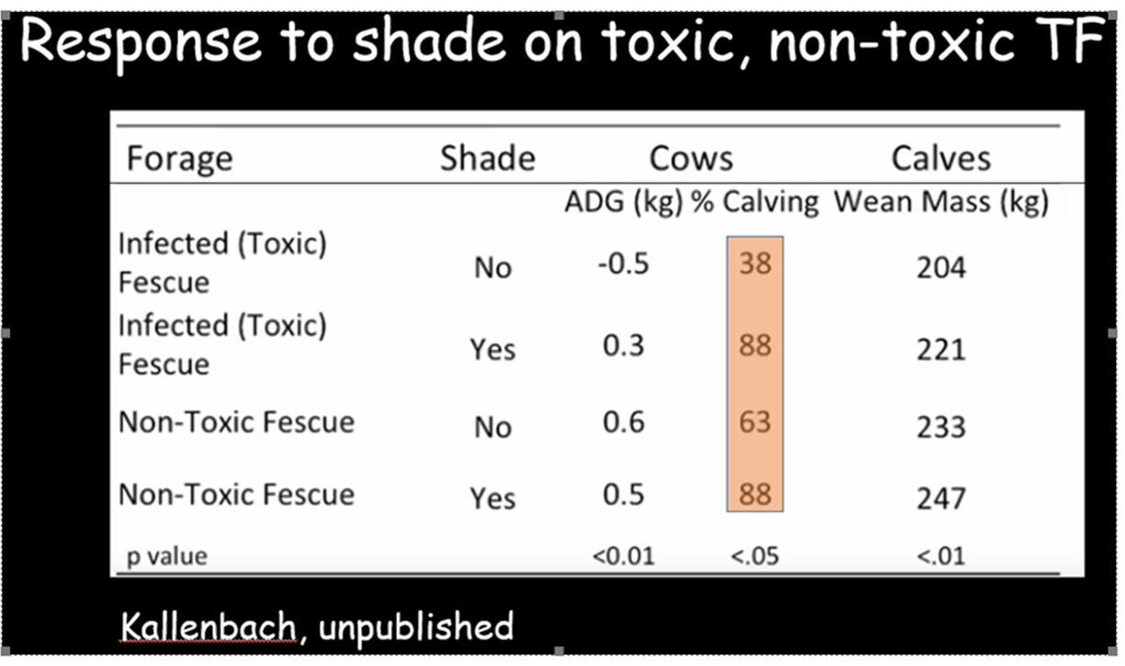
19
Notes:
Endophyte infected fescue is present throughout the fescue belt and this further impacts livestock health. This study done at the University of Missouri by Rob Kallenbach comparing pregnant cows on toxic and non toxic tall fescue with shade and without. Those without shade had a much lower calving rate.

Slide 39
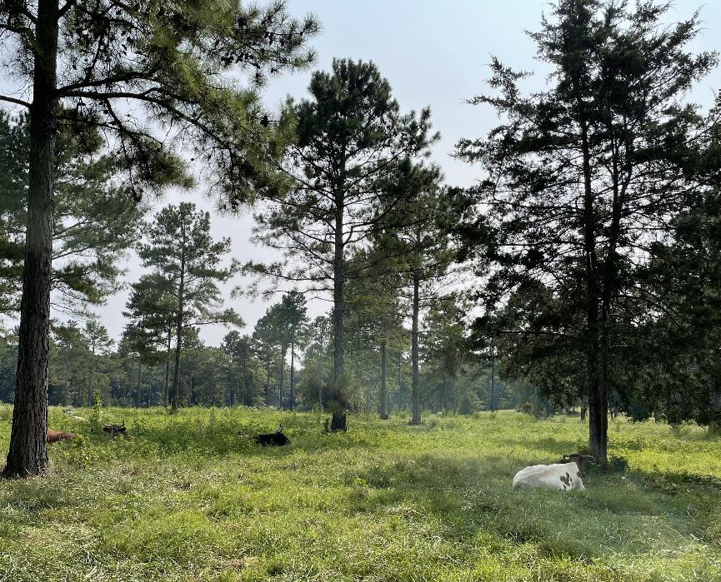
20
Notes:
Another image from pasture I showed earlier. This was a typical August mid-afternoon with fescue a primary forage. Note the cows in the shade. The difference between this system and a pasture with limited shade is that these cows can find shade easily. They are dispersed and have forage available within the shaded areas. All good.

Slide 40
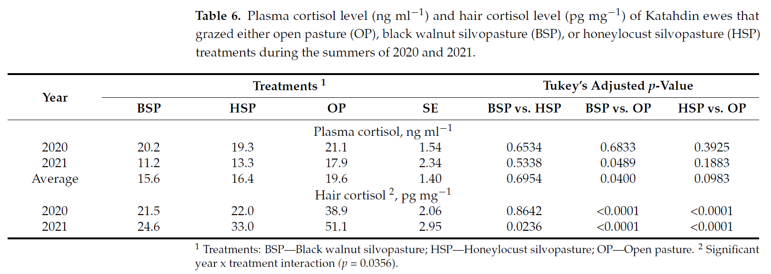
21
Notes:
Stress has an impact on animal performance, from grazing efficiency to reproduction. This study looked at the effects of shade availability on stress. This Table show plasma cortisol level and hair cortisol level of Katahdin ewes that grazed either open pasture, black walnut silvopasture, or honey locust silvopasture treatments during the summers of 2020 and 2021.

Slide 41
22
Notes:
Review the treatments. BSP = blackwalnut silvopasture, HSP = honeylocust silvopasture, and OP = Open Pasture. The red box shows blood cortisol levels. On average, cortisol levels were lower in blood plasma for silvopastures, though not significantly. However, hair cortisol levels were significantly lower in silvopastures vs open pasture. (researchers suggests that simply taking the blood samples increased cortisol levels while collecting hair samples was less…stressful). This tells us that animal stress levels are lower in the shade.

Slide 42
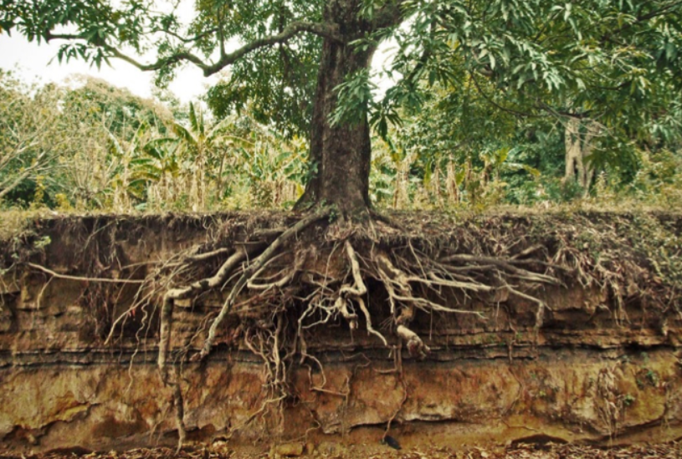
Soil Considerations
Buffers temperature fluctuations
Reduces evaporation
Shades soil surface
Organic matter
Fungal activity
Living roots
Notes:
Lets finally consider the impacts of trees on soils (discuss)
Buffers temperature fluctuations
Reduces evaporation
Shades soil surface
Organic matter
Fungal activity
Living roots

Slide 43
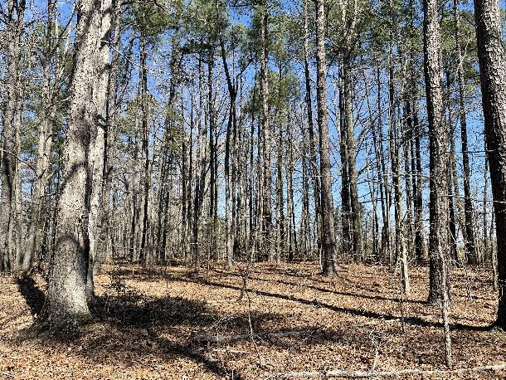
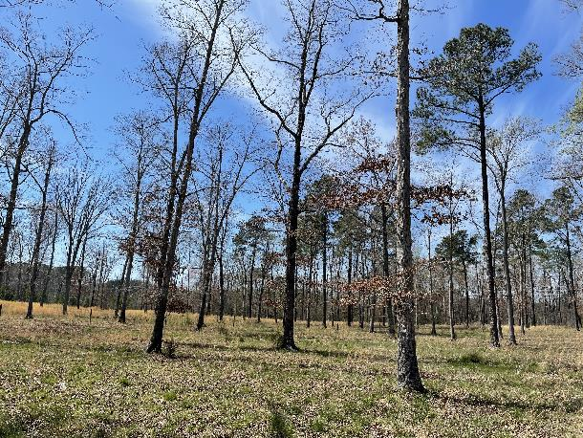
Soil Considerations – Silvopasture by Subtraction
Increased compaction
Loss/degradation of O-horizon
Reduced litter cover
Reduced C:N
Change in nutrient cycling
Change in root composition
Change in microbial composition
Notes:
A final note on soil impacts. While we can do a lot of good things for soils by adding trees into pasture systems, we can also damage forest soils by converting them to silvopastures. Some things to consider here (discuss).
The image shows a site that was converted from forest (top) to silvopasture (bottom). The trees that were already present were mature to overmature. The forest was also overstocked and contained stunted hardwood trees which typically don’t respond well to being “opened up”. Additionally, the site prep for seeding was extensive, which ultimately compacted soil and damaged root systems. End result is that a lot of the large hardwood trees (and some pines) are declining and dieing.
Bottom line, it Is important to plan silvopasture on the right sights with forages and trees that are compatible and tolerant of grazing impacts.
Increased compaction
Loss/degradation of O-horizon
Reduced litter cover
Reduced C:N
Change in nutrient cycling
Change in root composition
Change in microbial composition

Slide 44
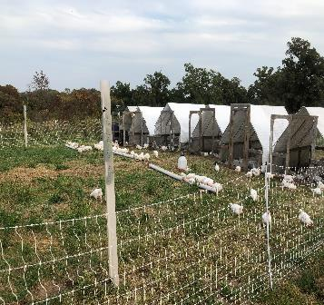
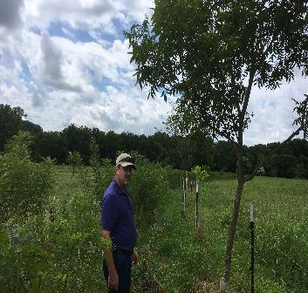
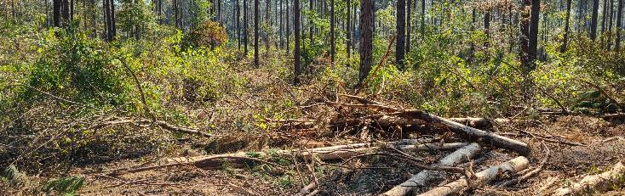
Silvopasture Establishment Overview
Notes:
Lets look at some key considerations for successful silvopasture establishment.

Slide 45
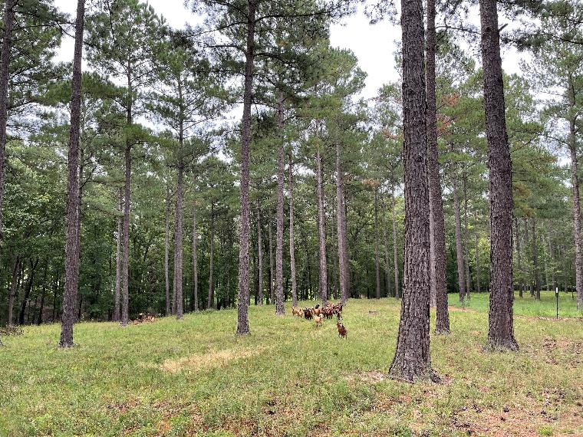
Silvopasture Establishment Methods
Silvopasture “by Addition”
Silvopasture “by Subtraction”
Other Scenarios?
  Adding livestock to orchards
  Overgrown Pasture “rescues”
Notes:
First, lets consider the two main approaches to silvopasture establishment. (read slide)

Slide 46
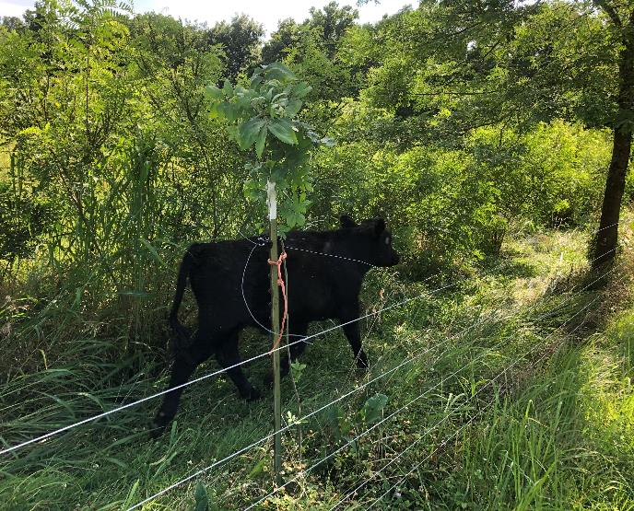
Silvopasture by Addition – Challenges and Considerations
Suitable site
Site prep and planting stock
Forage compatibility
Infrastructure
Tree protection from livestock
  Rows vs individual trees
  Consider deferred grazing or very short duration event
Tree protection from mechanical damage
Competition control
Grazing management
Notes:
First lets looks at adding trees to pasture. Some challenges to consider (read and discuss)

Slide 47


Successful Silvopasture Establishment… won’t happen if trees are dead!
vs
Notes:
Guidance for proper establishment and protection is often missing in early conversations and planning. This is an important thing for conservation planner to recognize. If they cannot advise on tree establishment, then they should reach out to forester for assistance.

Slide 48
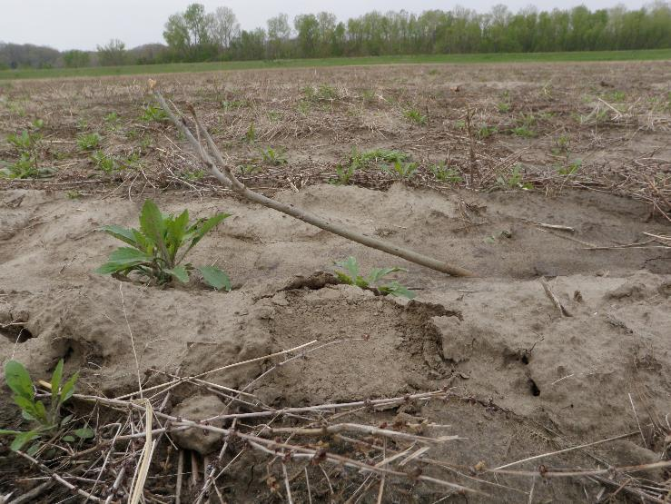
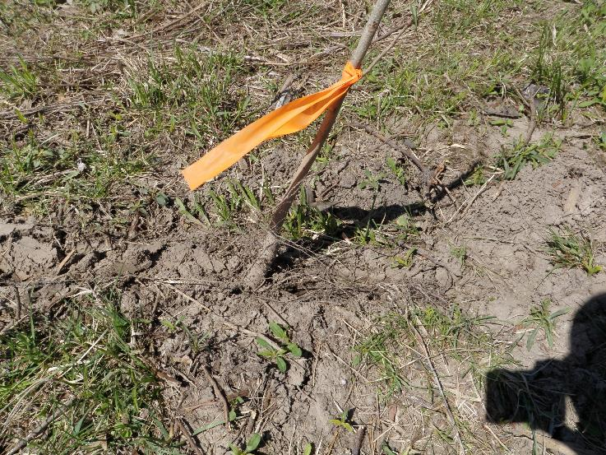
Not Successful Tree Establishment…
Notes:
Examples of poor planting and less-than-great planting stock.

Slide 49
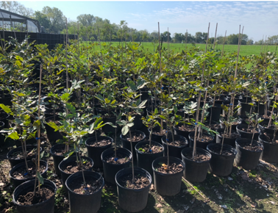
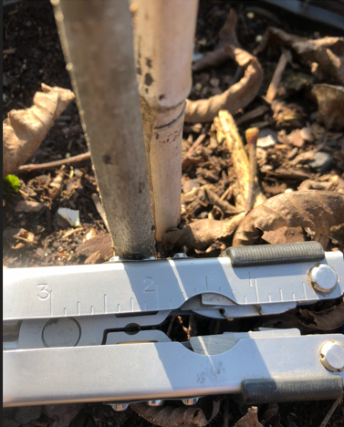
High Quality Planting Stock
Notes:
Excellent planting stock. Container trees are expensive but have many benefits: typically will have greater survival and better early growth (though well planted bare root trees will usually catch up). They also offer more flexibility in planting window. Fall is best time to plant container stock, but can be done in spring and almost any time when moisture is available. Bareroot stock are generally limited to spring planting only due to nursery production processes.

Slide 50

Tree Protection
Notes:
If we want to guarantee tree planting success, we need to be serious about protecting trees from livestock damage. This starts with good grazing management but effective barriers are an important piece also.. This image shows electrified “hoops” around individual trees.

Slide 51


Tree Protection cont.
Notes:
Image on the left shows a tree “cage” which is effective against almost all livestock in almost all situations (nothing is perfect). Image on the right shows what has become recognized as the “overpass” system. Tree tubes are spiral wrapped with electrified polywire and the power is carried to the next tree by an overhead length of polywire. This allows for more efficient grazing access, rather than dividing pastures up with polywire ran at the usual height.

Slide 52

Tree Protection continued
Notes:
This shows trees planted in blocks with grazing alleys between (grazed area is yellow; was hot and dry). A single polywire around the block of trees keeps the larger cows out, while calves can enter and graze with little impact on trees.

Slide 53

Silvopasture by Subtraction – Challenges and Considerations
Suitable site
Target canopy cover
Suitable residual trees
Damage to residual trees
Woody debris & stumps
Compatible forage
Invasive species control
Planning for regeneration (establishing or controlling!)
Infrastructure
Compaction
Impacts on wildlife and soil organisms
Notes:
Now lets looks at thinning forested sites and adding forages.
Suitable site
Target canopy cover
Suitable residual trees
Damage to residual trees
Woody debris & stumps
Compatible forage
Invasive species control
Planning for regeneration (establishing or controlling!)
Infrastructure
Compaction
Impacts on soil organisms

Slide 54

23
Notes:
Conditions will vary but tree thinning will generate a lot of material to treat and remove. Prepping the site for seeding can be a challenge.

Slide 55

24
Notes:
In this instance, the landowner cleared trees from a 50’-wide alley, they kept 50 of trees, then another 50’ alley, and continued that process throughout the stand. Note that this switchgrass, a warmseason forage. It was selected here due to lower cost of establishment compared to prepping low pH, low fertility soils for cool season forage.

Slide 56



25
Notes:
These images show a silvopasture system in Georgia. Here, cattle are grazing in thinned loblolly pine plantations where forages have been established. Notice the light and relatively even distribution of shade shown on the ground. Image on the left also points out placement of water tank. Laying out infrastructure in an established forest site takes additional planning.
Silvopasture in GA, Michael Sampson and Philip Brown

Slide 57


Silvopasture - Examples
Notes:
Here are some good examples of silvopasture in the Pacific Northwest. These are natural stands that have been managed to provide adequate sunlight for forage growth and prescribed grazing is used to manage forage availability. This is blurs the line with a range system; main difference here was presence of some introduced forages.
Mark Batchelor, NAC.

Slide 58

26
Notes:
Hardwood systems can be more difficult to manage for silvopasture, depending on species and site. However, this system in NY is functioning at a high level and combines cool season forages with black walnut and black locust trees. In this case the understory was a mix of non-native and other undesirable woody vegetation and the silvopasture has improved residual tree health.

Slide 59


27
Notes:
As discussed earlier, converting other hardwood forest types can be challenging. Both images show mature oak forests or woodlands that were thinned for silvopasture establishment. Image in the upper left was recently established and time will tell the impacts (this is a research site and impact on mature hardwoods is a study objective). Image on the right was used earlier to show effect of converting mature forest; again, mature, suppressed (from overstocking) trees combined with extensive site prep have not been kind to the residual hardwood trees.

Slide 60


Other Scenarios
Notes:
Other scenarios to consider include using livestock as a means to manage vegetation in orchard systems. (pecans in lower left, fruit orchard in upper right).

Slide 61

28
Notes:
This image shows a stand of eastern redcedars that were thinned over time. This was an old pasture that had become choked with cedar trees, reducing forage availability. Rather than removing all of the trees though, the landowner thinned them out, and retained some for shade. Note that the trees have also been pruned to allow grazing access and shade access! How many overgrown pastures have you seen that could be easily converted into silvopastures like this!

Slide 62
Thank you!
For more information on Managing Soil Health,
visit us here:
https://www.nrcs.usda.gov/conservation-basics/natural-resource-concerns/soils/soil-health
USDA is an equal opportunity provider, employer, and lender.

